Slide 1
GIST NetAI Laboratory Winter Internship Program Presentation
Data Pipeline & Cloud Native Data Lakehouse
2022/05/09
20175091 Song, JaeMyung

Slide 2
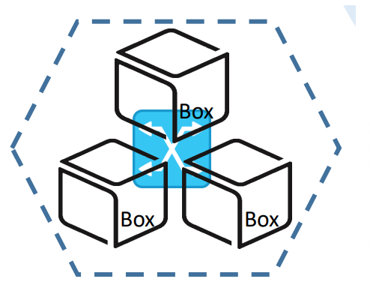
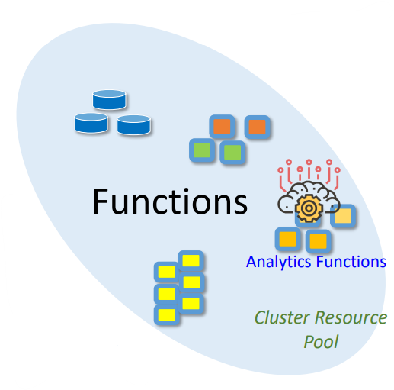
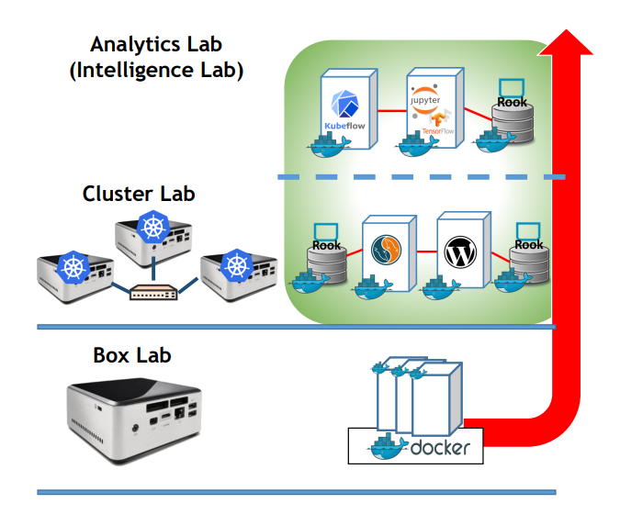
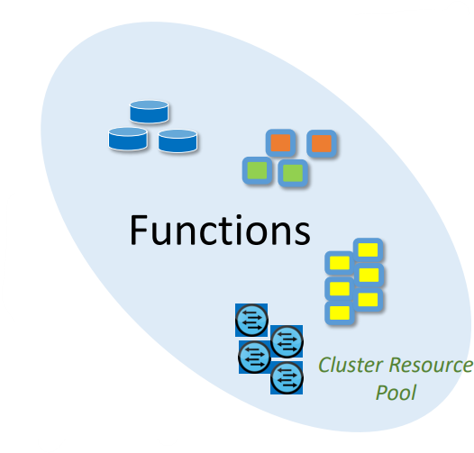
Cluster Lab & Analytics Lab
Analytics Lab
Cluster Lab

Slide 3
Data Pipeline
Data Processing
ETL
Type of Data
Data Generation
Service Data
SaaS
Visualization
Log Data
Self-Managed
ELT

Slide 4
ETL vs ELT
Data
Data
Extract
Small Staging Area
Extract
Privacy Data
Staging Area
Transform
Load
Data Lake
Load
Difference
Transform
Data Warehouse
Staging Area
Privacy Data
Benefit of ETL
Benefit of ELT
Efficient Data Analysis
Deal with Privacy Problem
Various Platform
Fast
Cloud native
Small Load Time

Slide 5
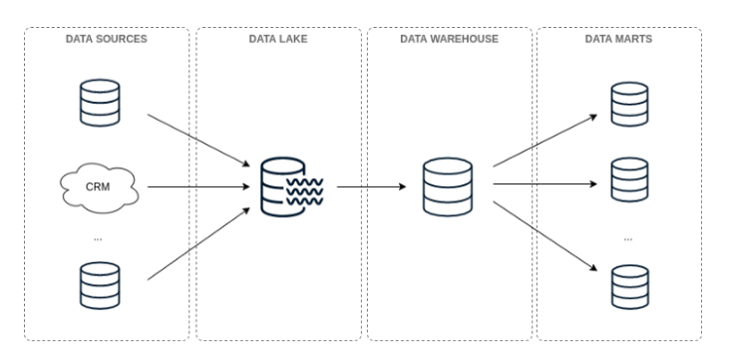
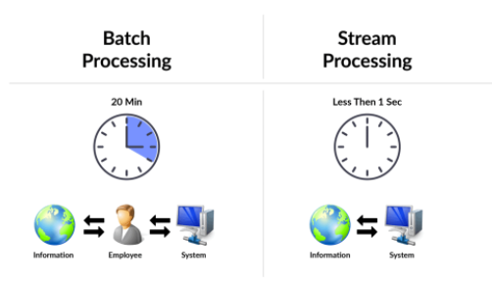
Basic Architecture (Old)

Slide 6
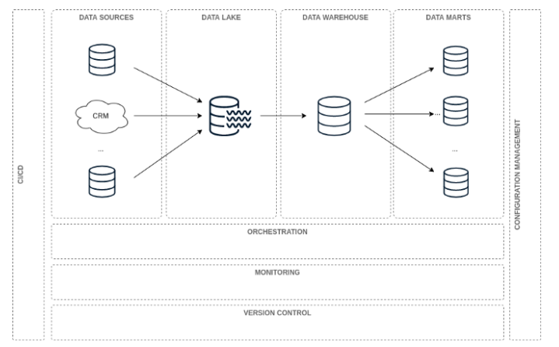
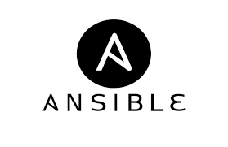










Last Topic (Old)

Slide 7
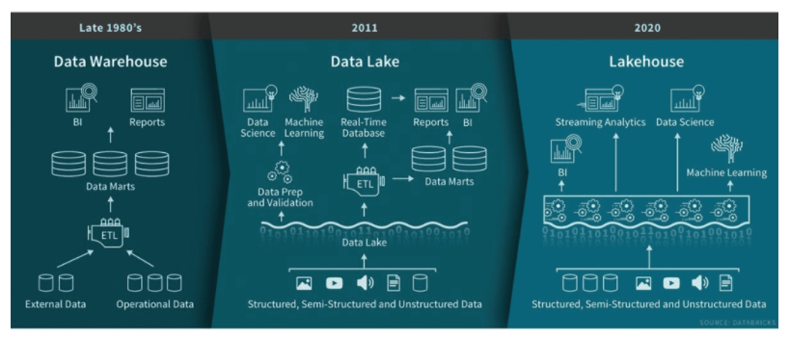
Basic Architecture (New)
ETL with DWH, Data Lake -> ELT with Data Lakehouse

Slide 8

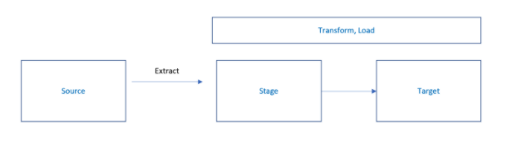




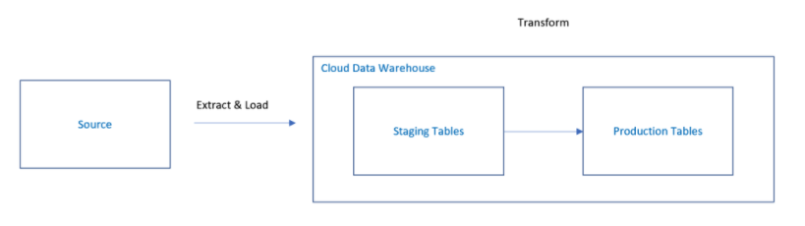
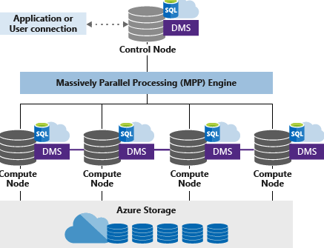
ETL to ELT with Data Lakehouse
ETL with No Data lake
Volumes<1TB
ELT with Cloud DWH
Volumes>>1TB

Slide 9
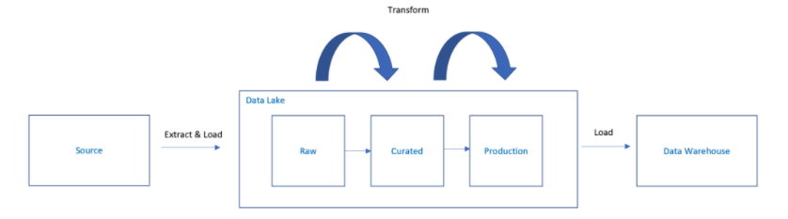
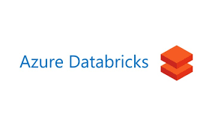


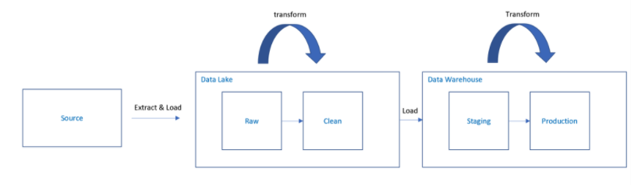
ETL to ELT with Data Lakehouse
Last Week
ELTL with DWH + Data Lake
Big data volumes
(TB – PB – EB scale)
ELtLT with DWH + Data Lake
Big data volumes
(TB – PB – EB scale)

Slide 10
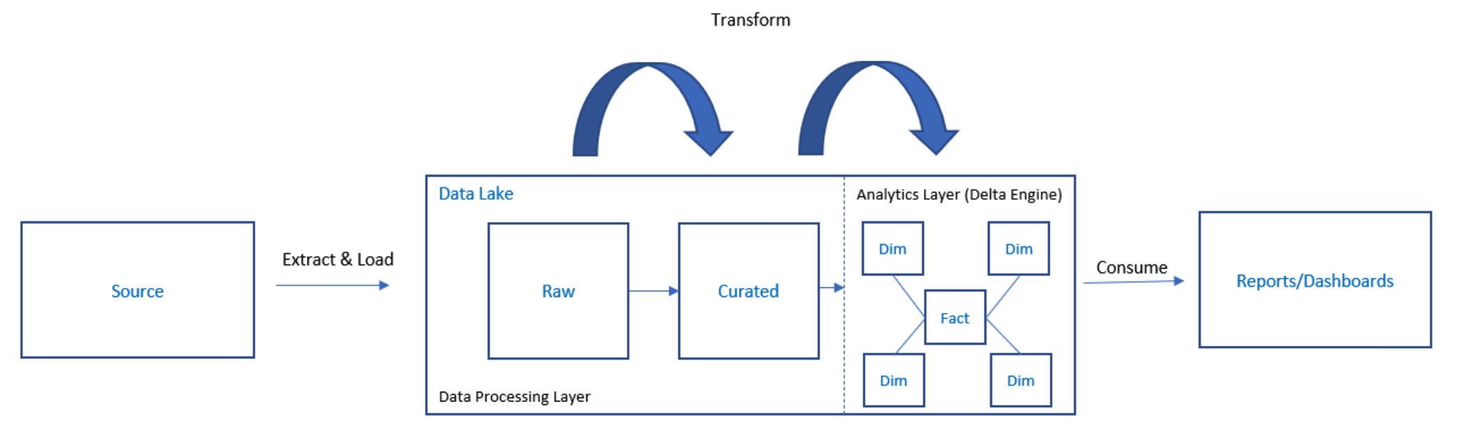


ETL to ELT with Data Lakehouse(Old)
ELT with Data Lakehouse
Data Lakehouse

Slide 11
Basic Architecture (Old)

Slide 12
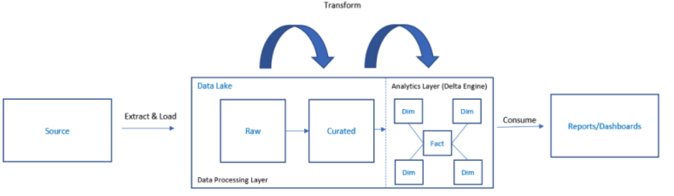

Basic Architecture (Old)

Slide 13
Delta Lake
Problems with Data Lakes
ACID Transactions
/path/to/table/_delta_log
- 0000.json
- 0001.json
- 0002.json
- …
- 0010.parquet
Hard to append data
Modification of existing data is difficult
Jobs failing mid way
Real-time operation is hard
Costly to maintain versions of data

Slide 14
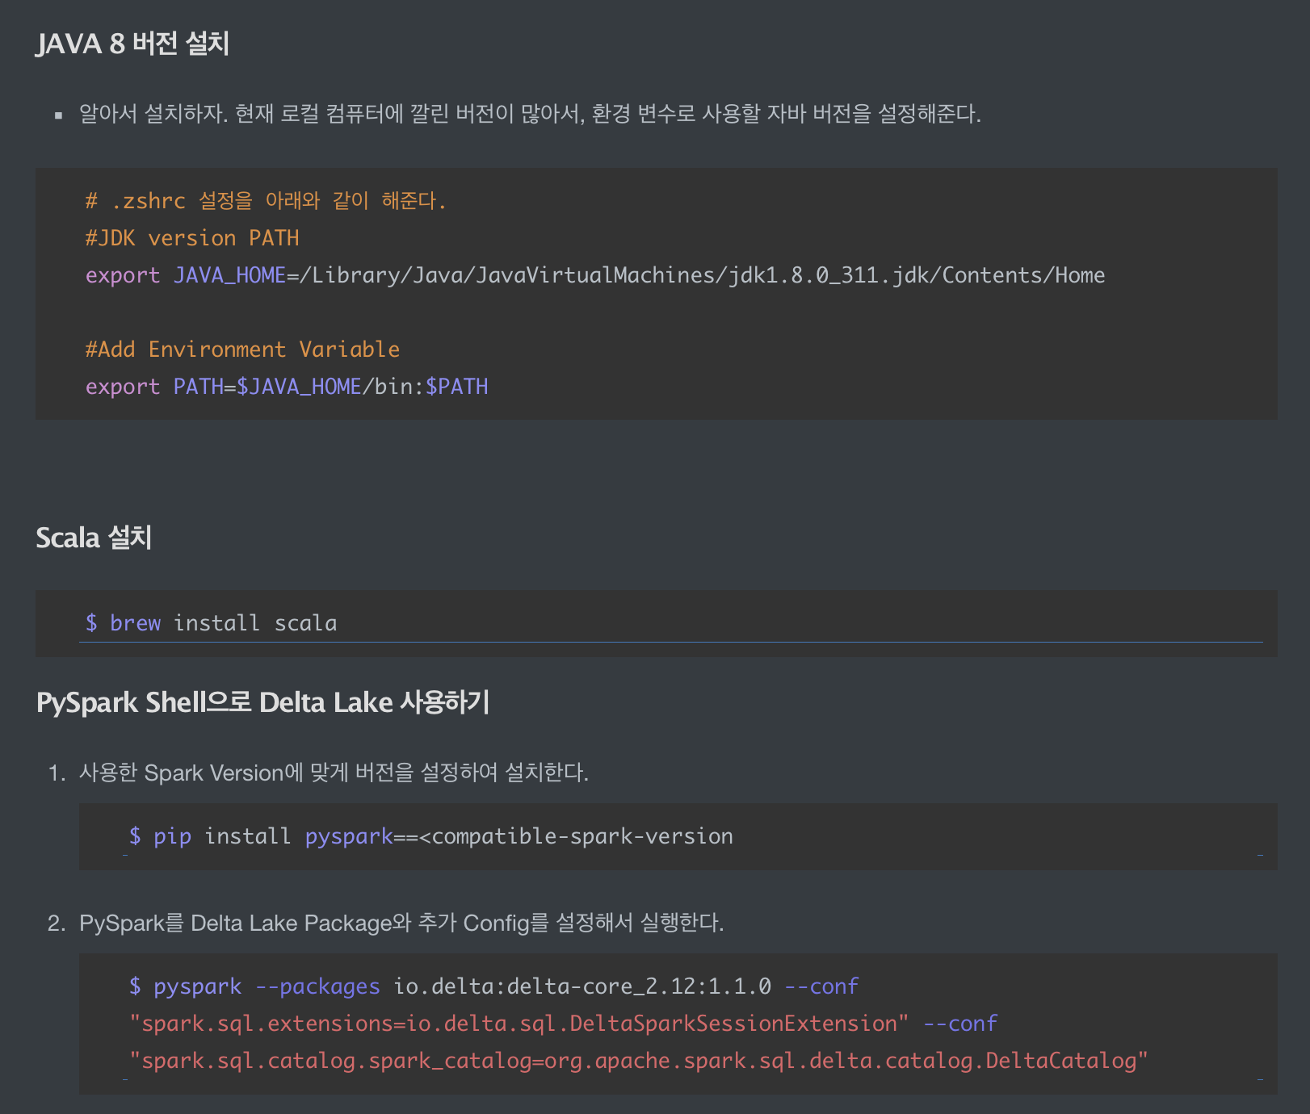
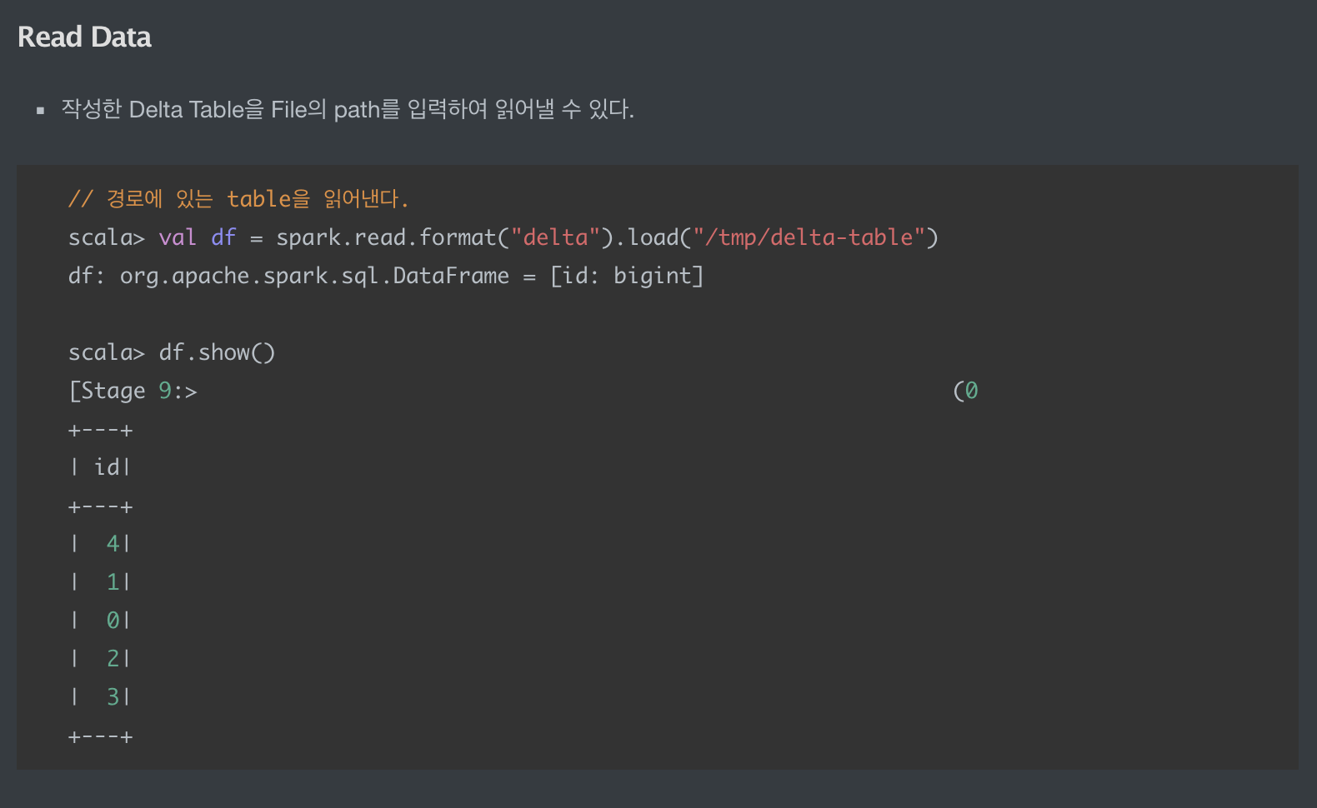
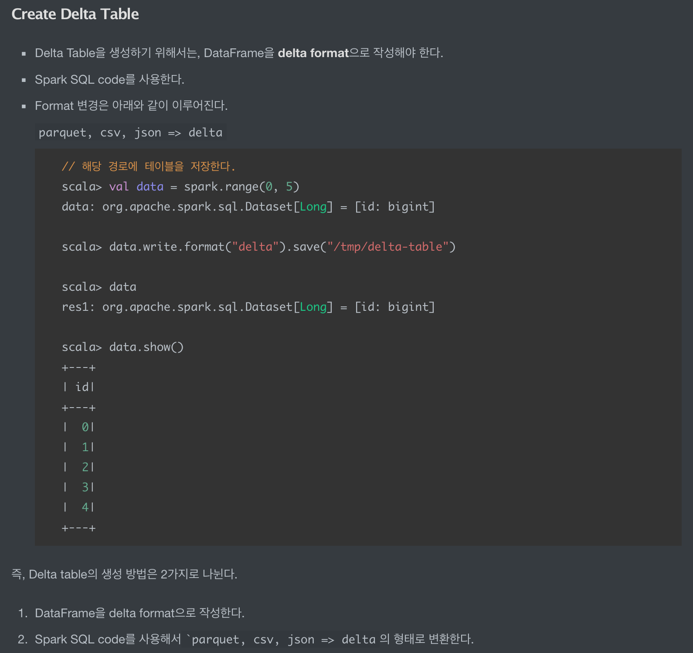
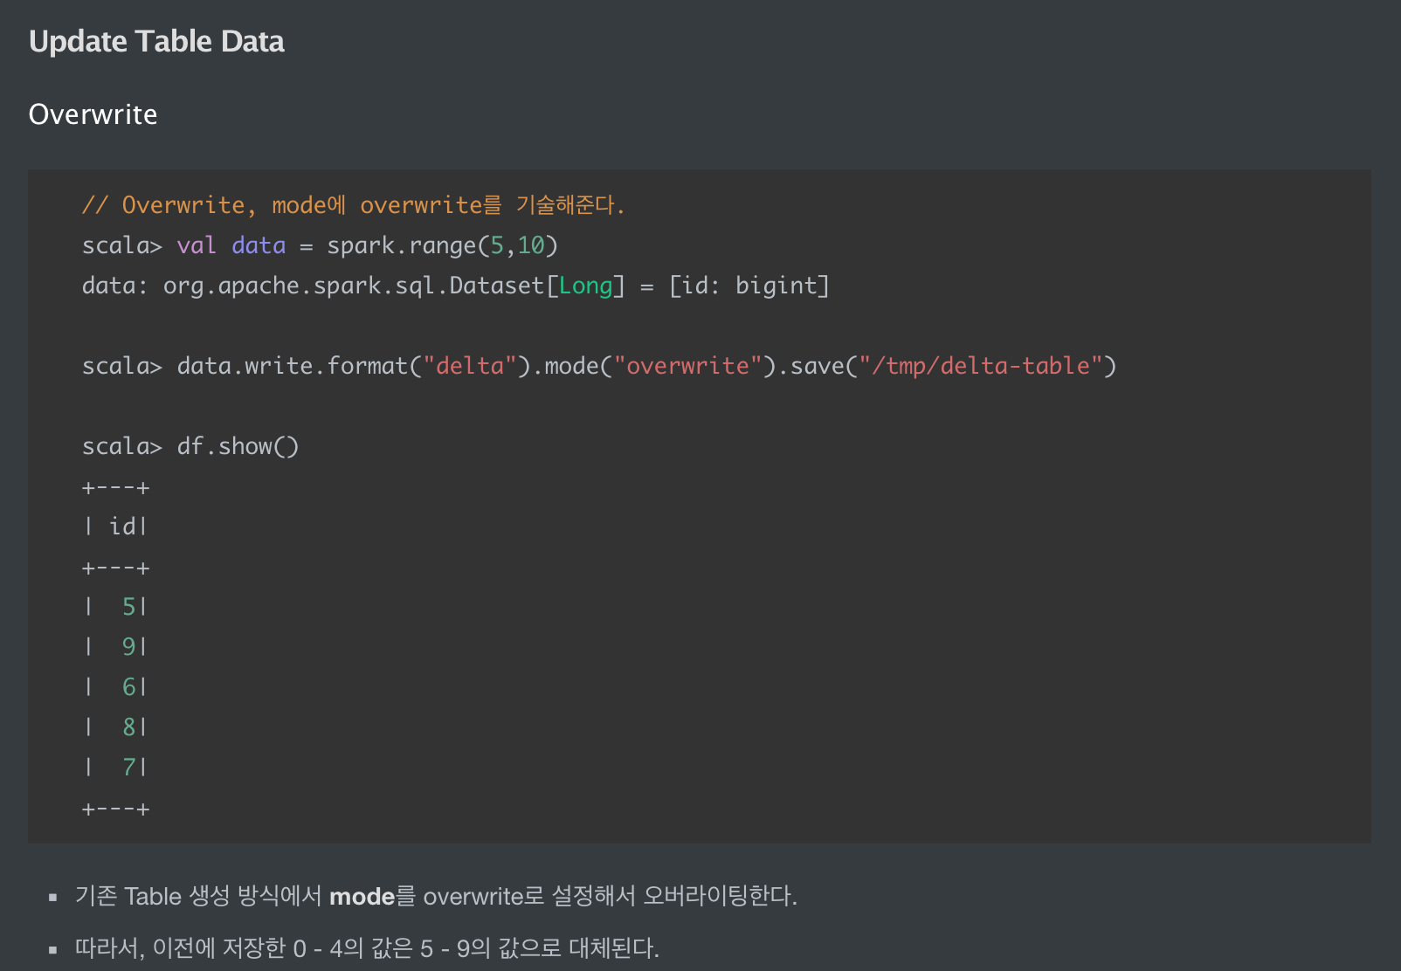
Delta Lake
Format
parquet, csv, json => delta

Slide 15
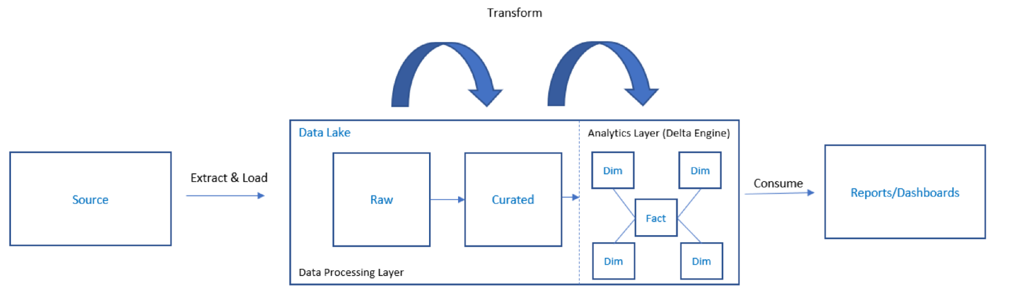
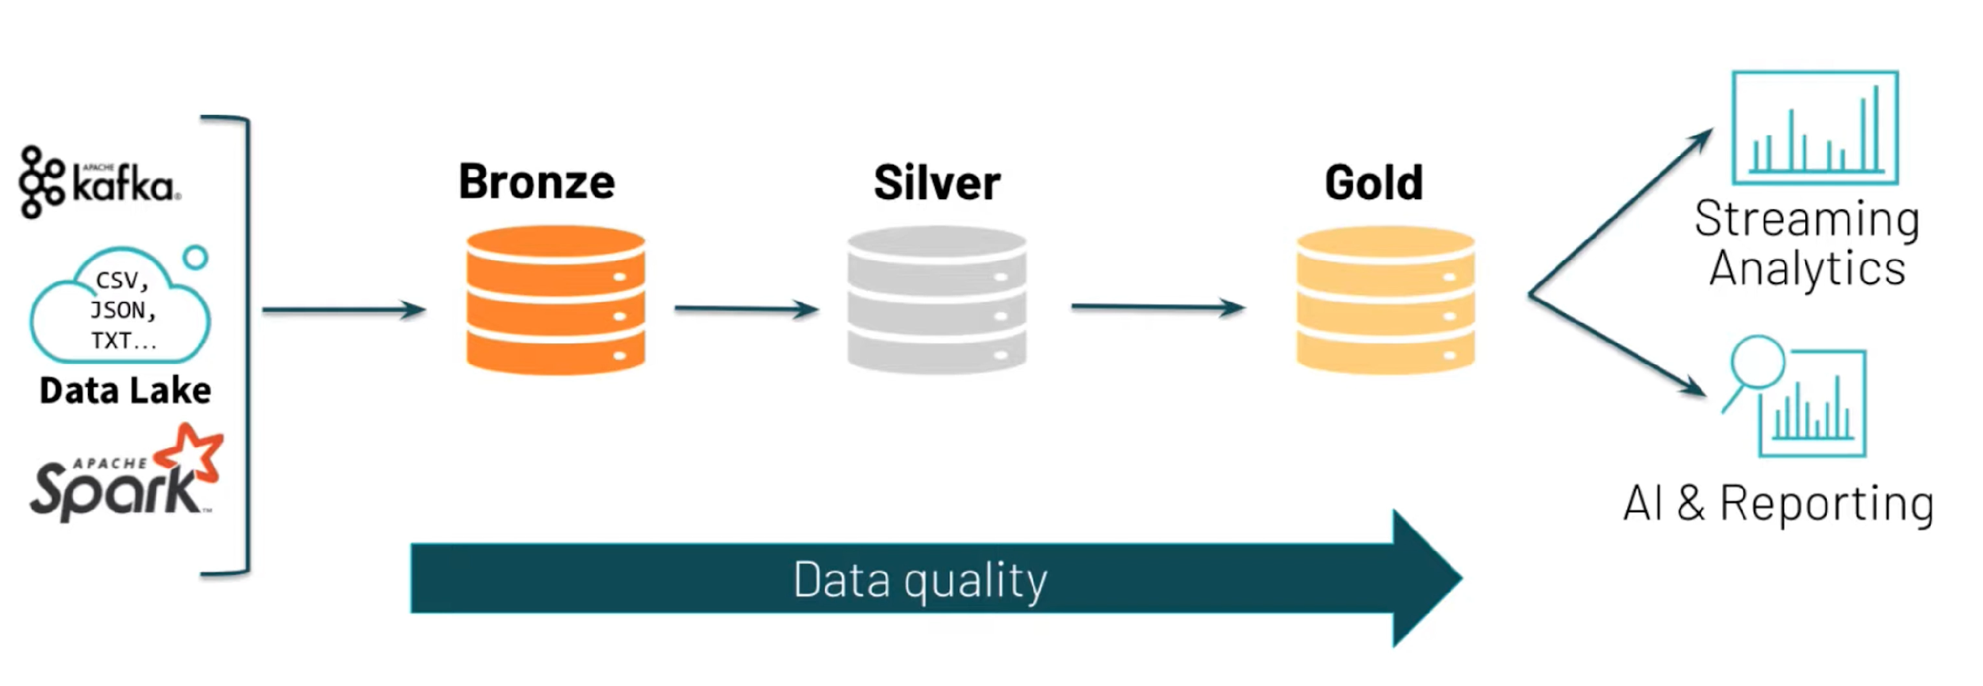
Data Lakehouse Architecture

Slide 16
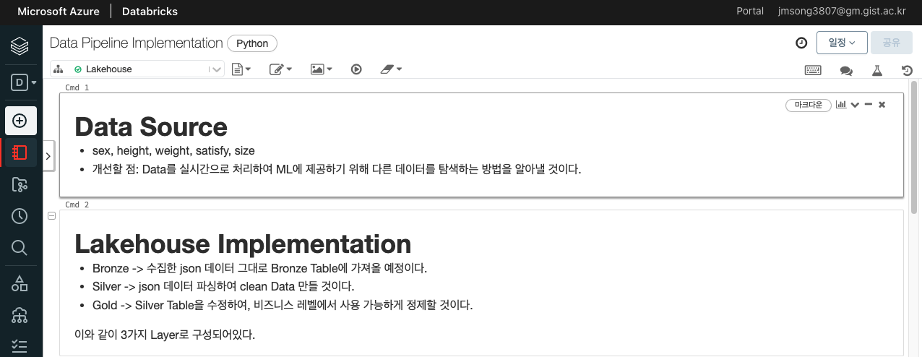

Data Lakehouse Architecture (Practice)
Sex
Height
Weight
Size
Satisfaction

Slide 17
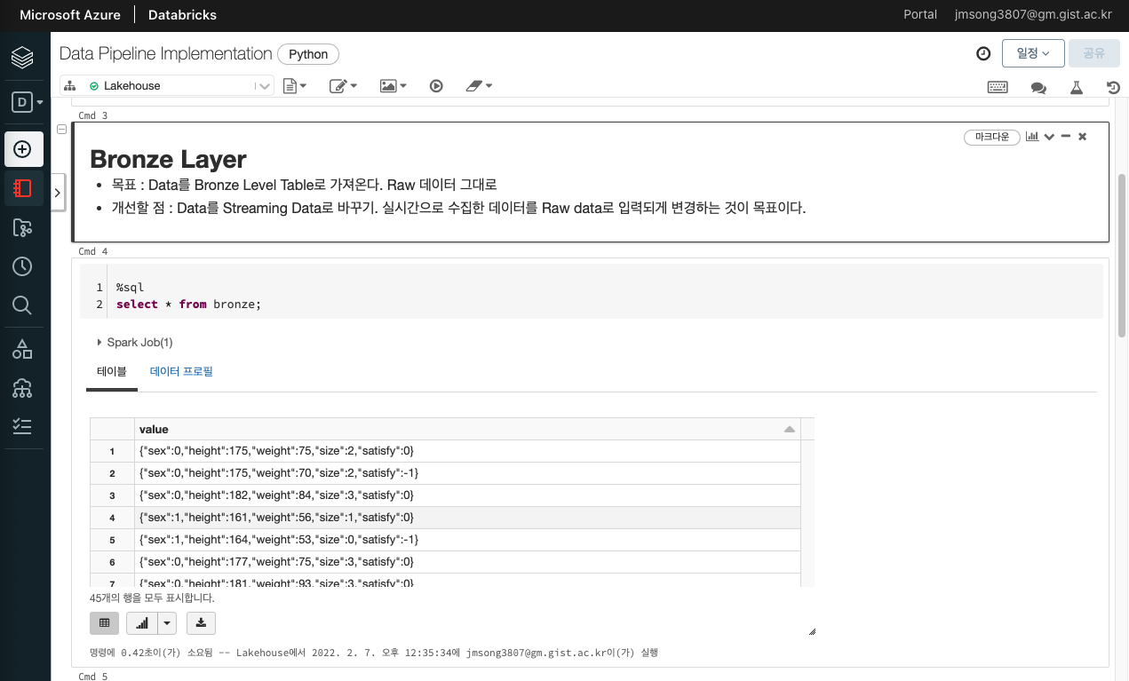
Data Lakehouse Architecture (Practice)
Sex
Height
Weight
Size
Satisfaction

Slide 18
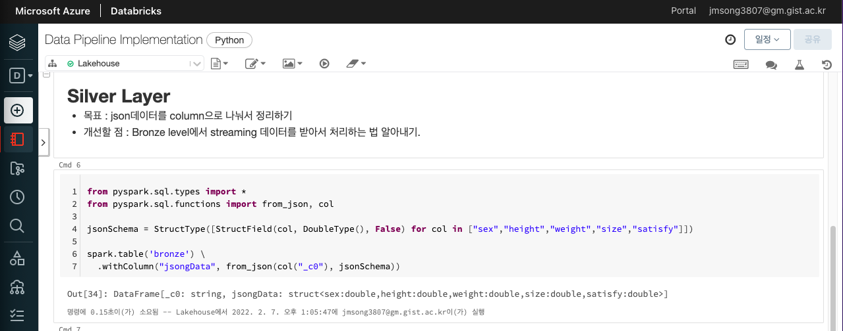
Data Lakehouse Architecture (Practice)
Sex
Height
Weight
Size
Satisfaction

Slide 19
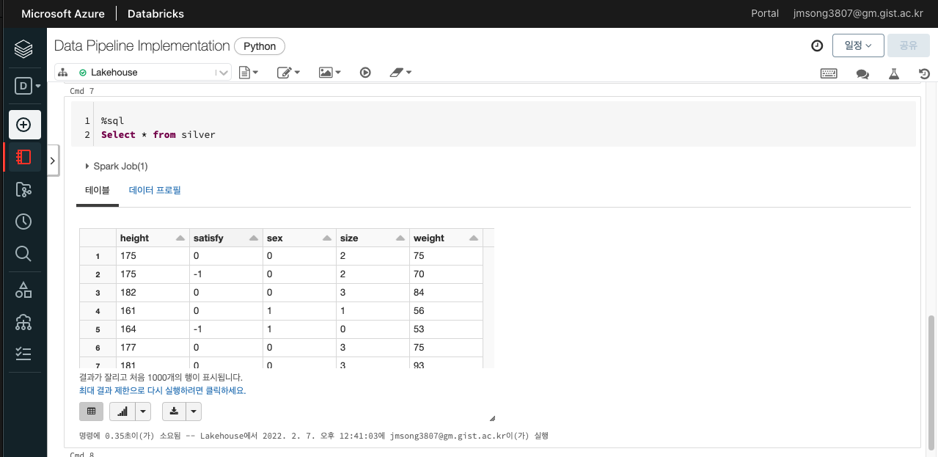
Data Lakehouse Architecture (Practice)
Sex
Height
Weight
Size
Satisfaction

Slide 20
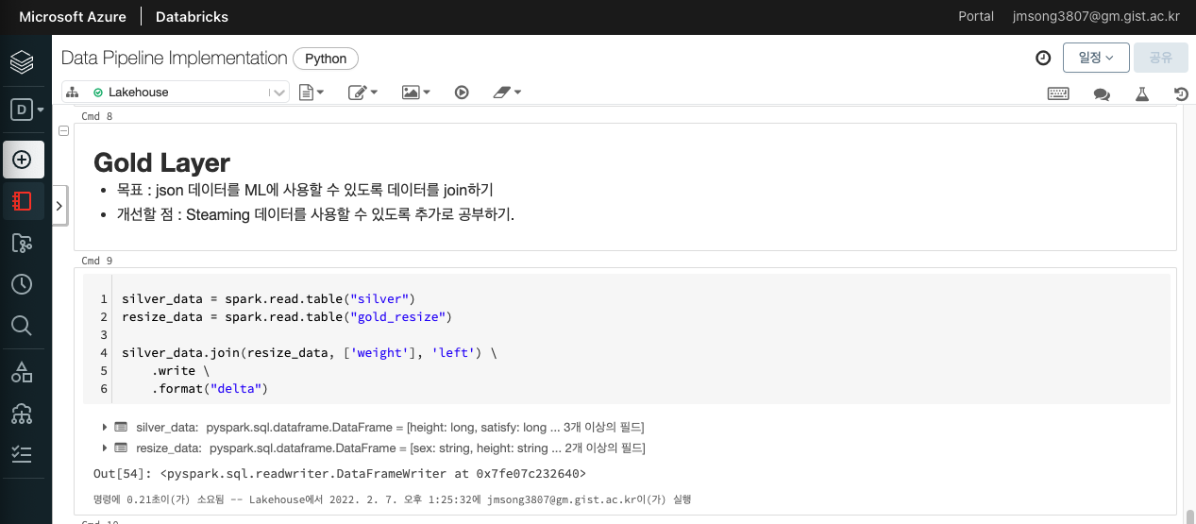
Data Lakehouse Architecture (Practice)
Sex
Height
Weight
Size
Satisfaction

Slide 21
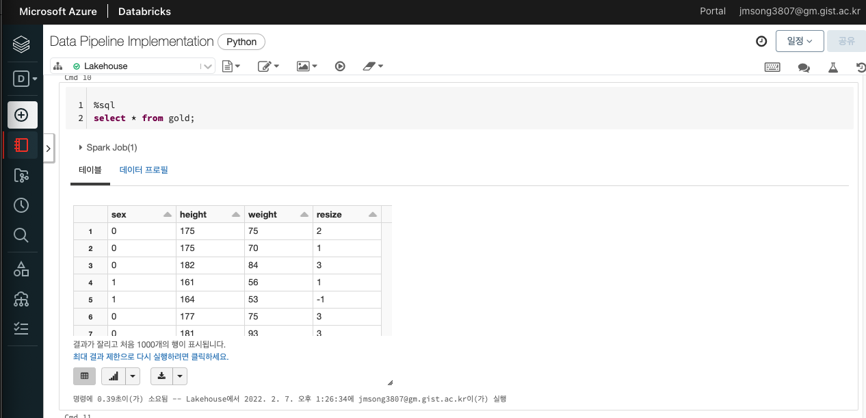
Data Lakehouse Architecture (Practice)
Data For Business Level
Sex
Height
Weight
Size
Satisfaction

Slide 22
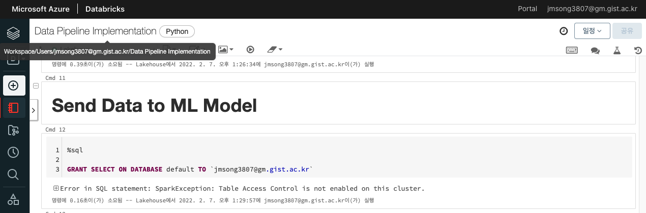
Data Lakehouse Architecture (Practice)
Sex
Height
Weight
Size
Satisfaction

Slide 23
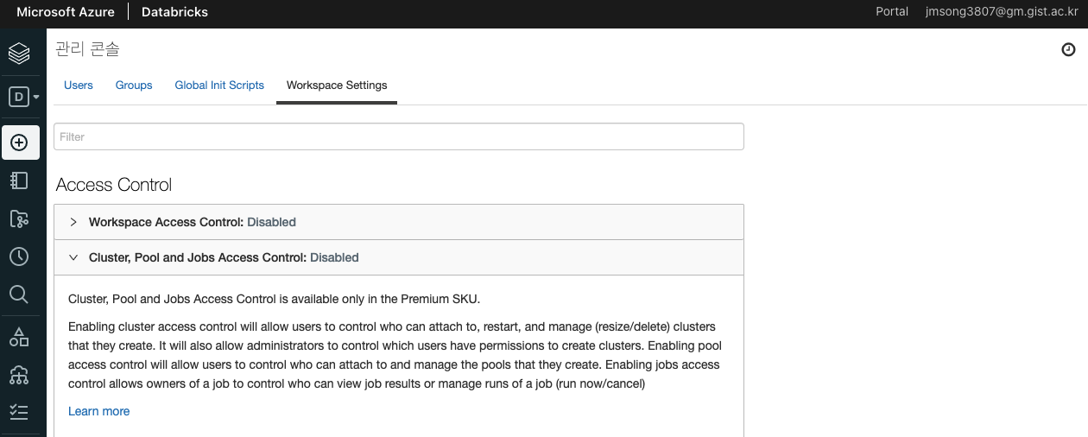
Data Lakehouse Architecture (Practice)
Sex
Height
Weight
Size
Satisfaction

Slide 24

What to do

Slide 25
Improvement
SQL
Spark
Delta Lake
Batch Data -> Streaming Data
Cluster Configuration -> On-premise

Slide 26
Data Lakehouse Architecture (Old)
2. What is clean?
3. Proper Data
1. Cluster Configuration -> On-premise

Slide 27
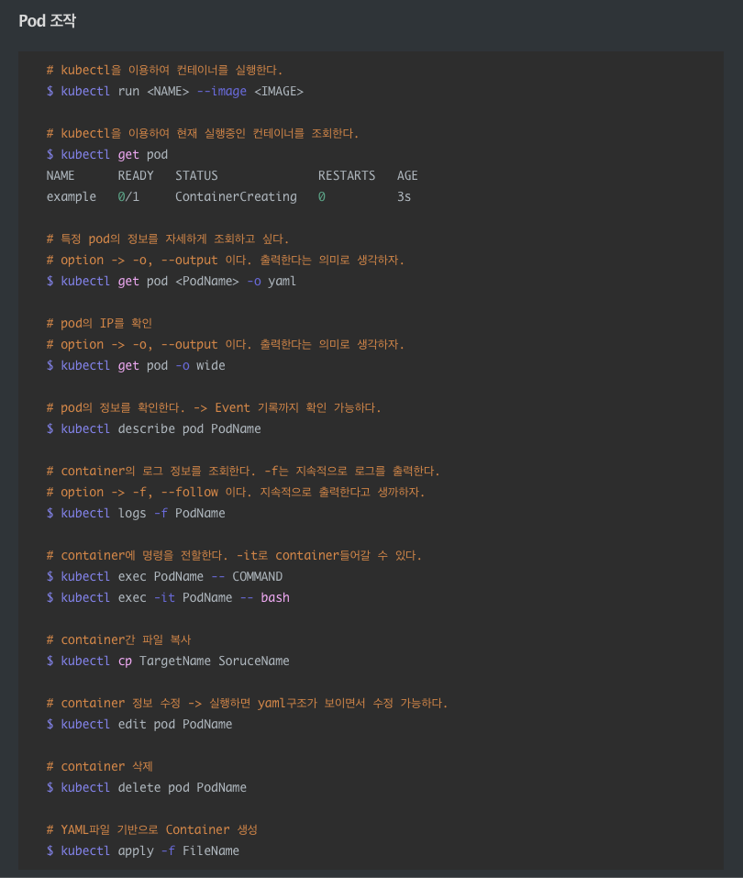
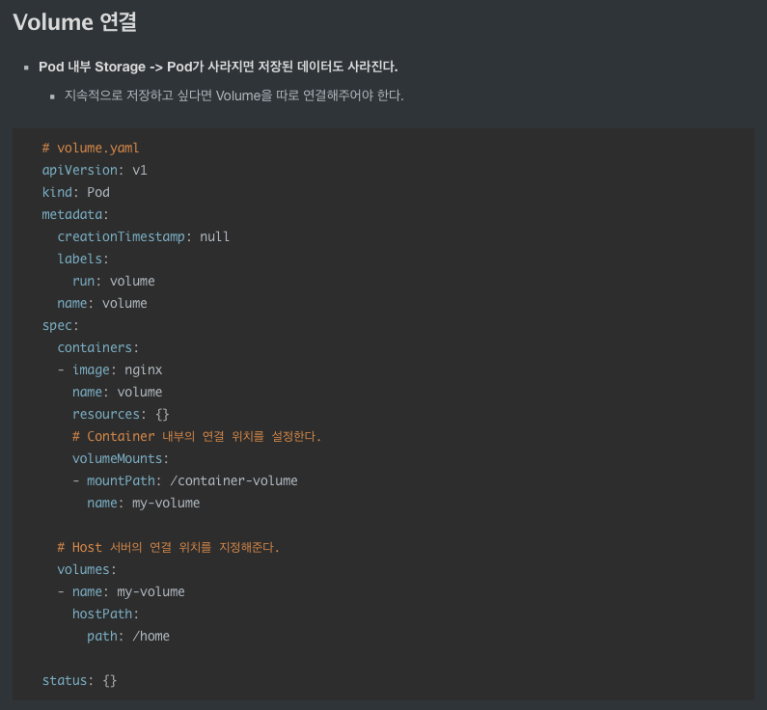
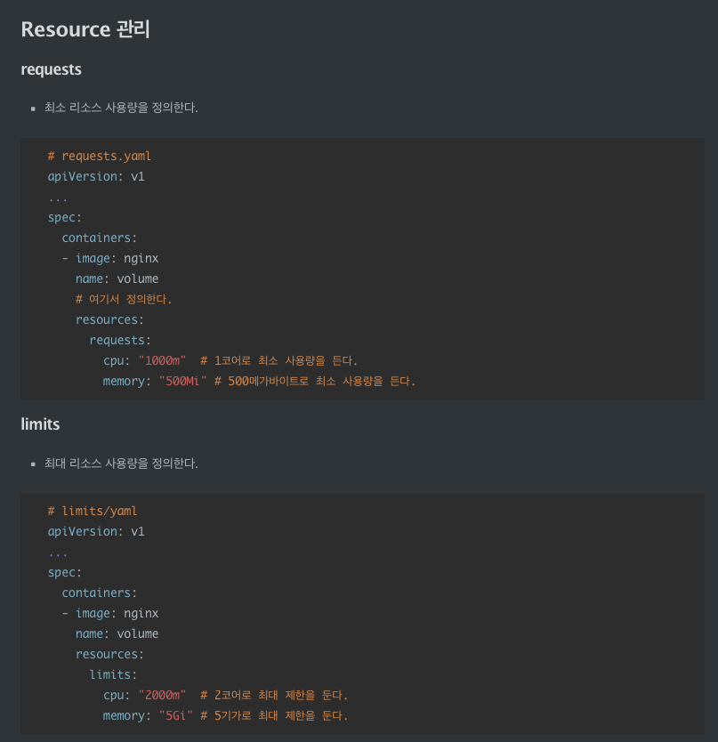
K8S Configuration Study - Pod
Pod Setting
Volume setting
Resource setting

Slide 28
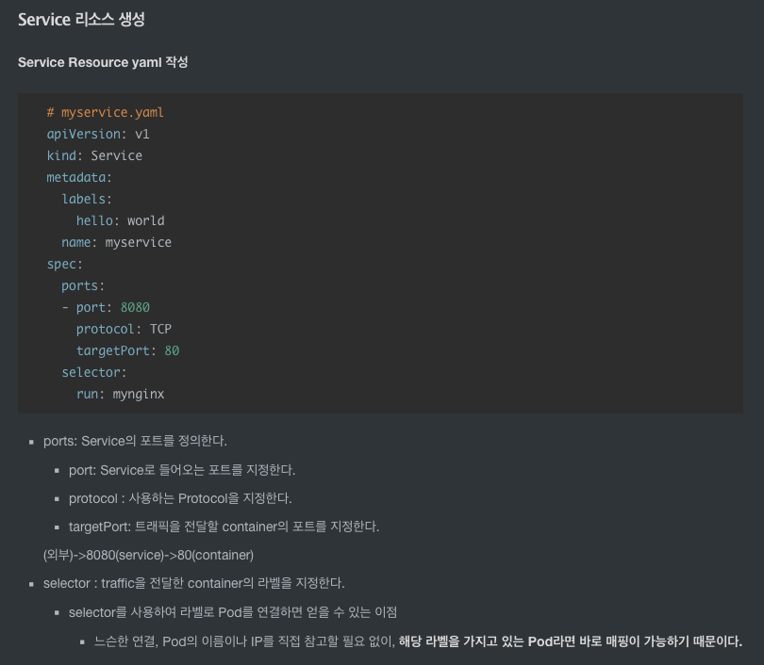
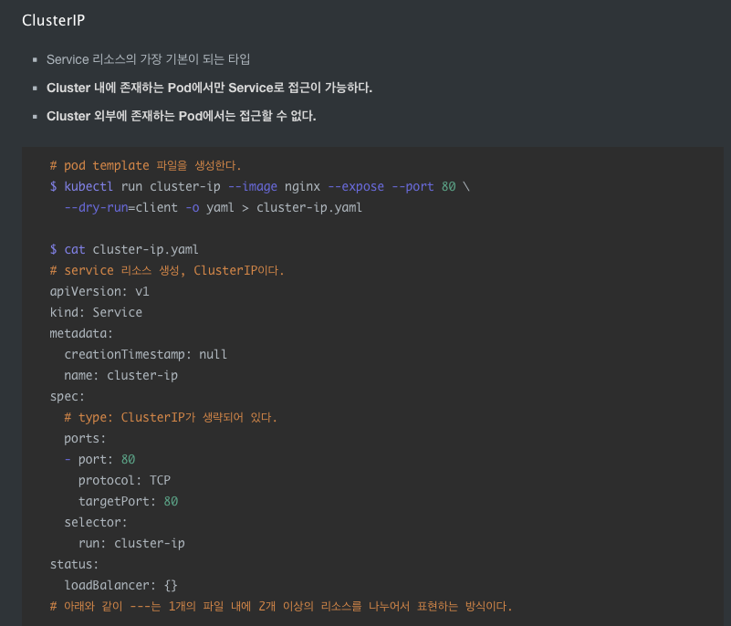
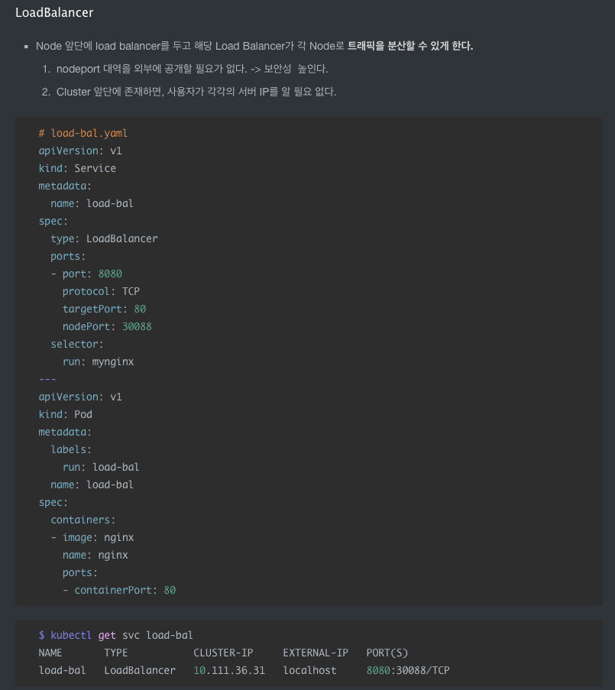
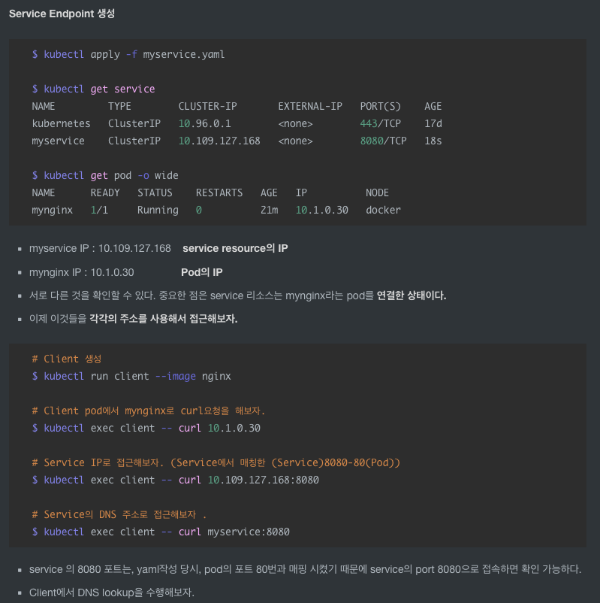
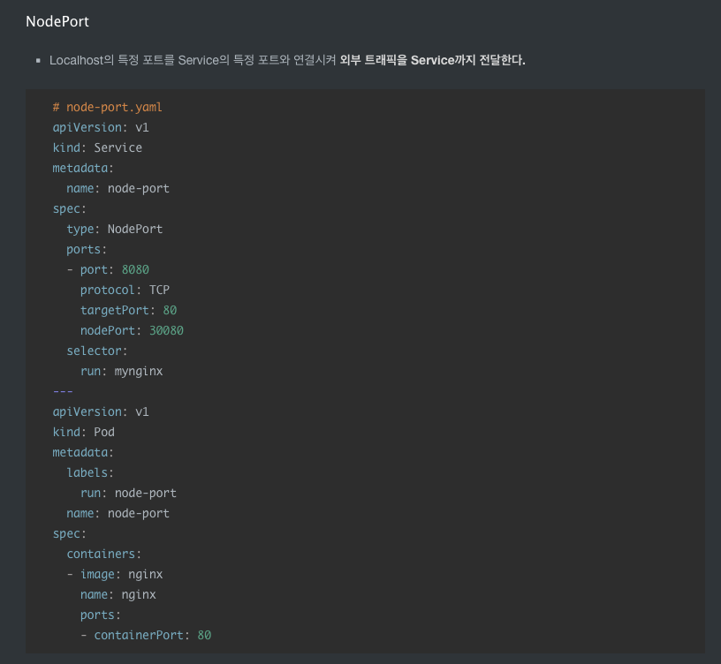
K8S Configuration Study - Service
Service Setting
ClusterIP
LoadBalancer
Nodeport

Slide 29
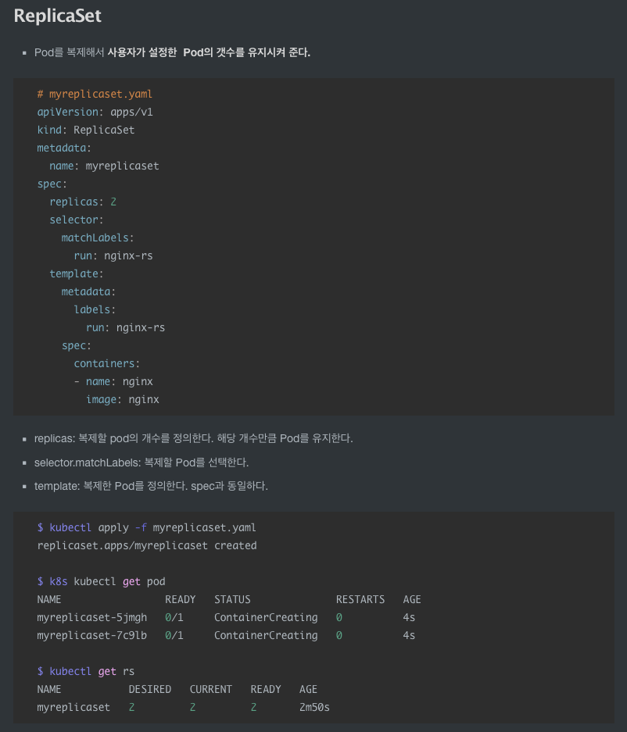
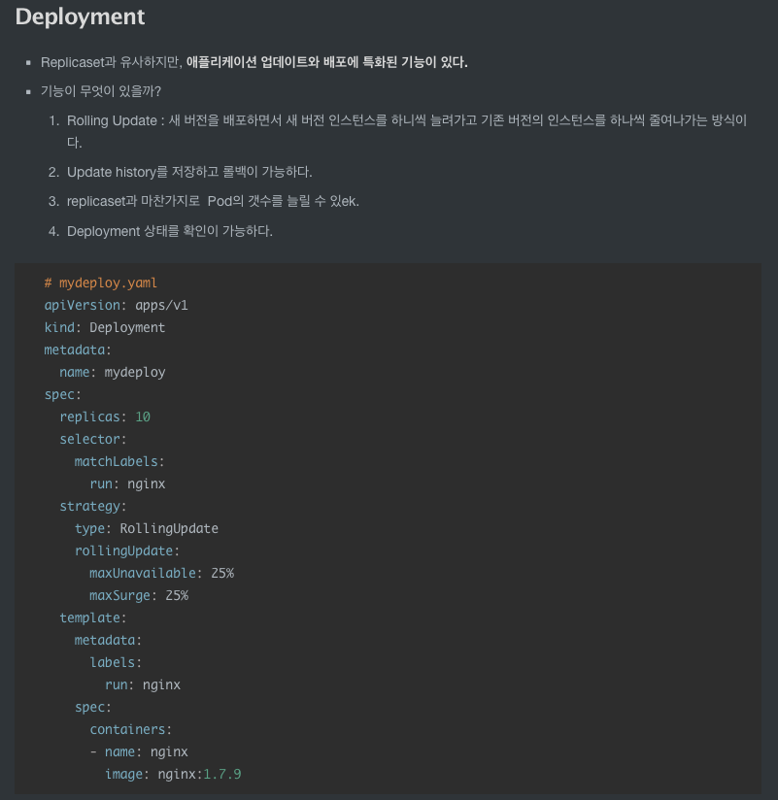
K8S Configuration Study - Controller
ReplicaSet
Deployment

Slide 30
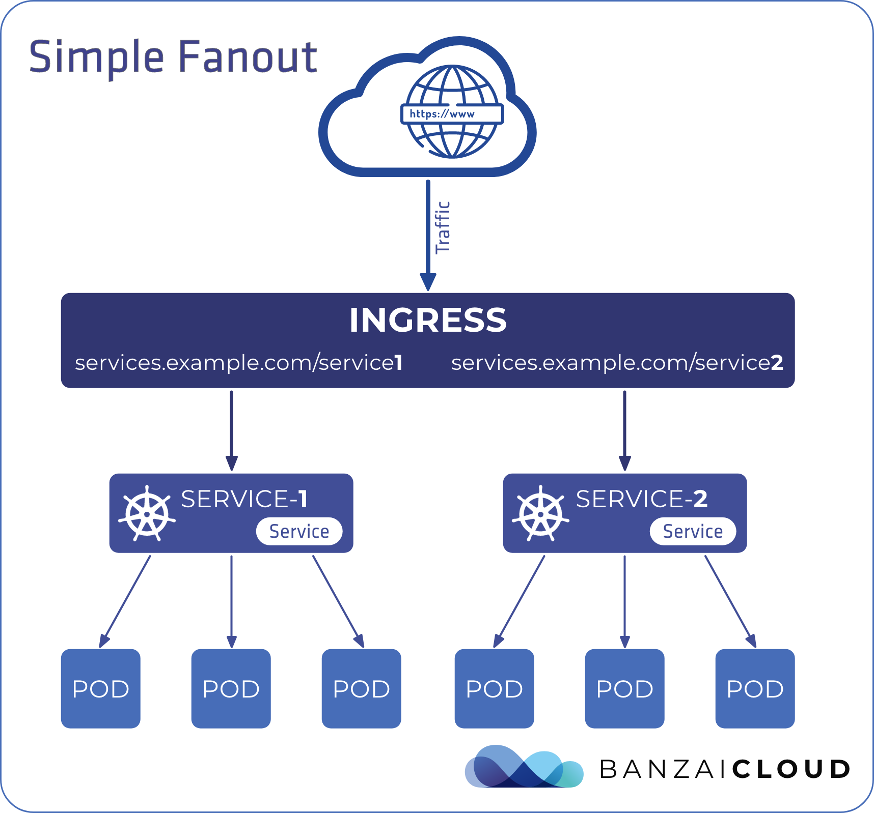
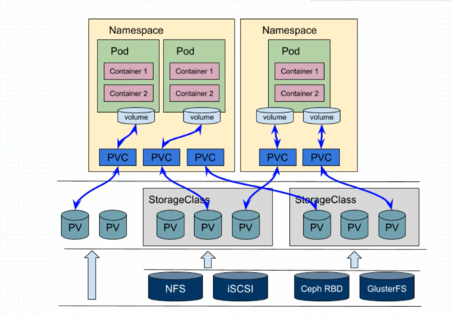
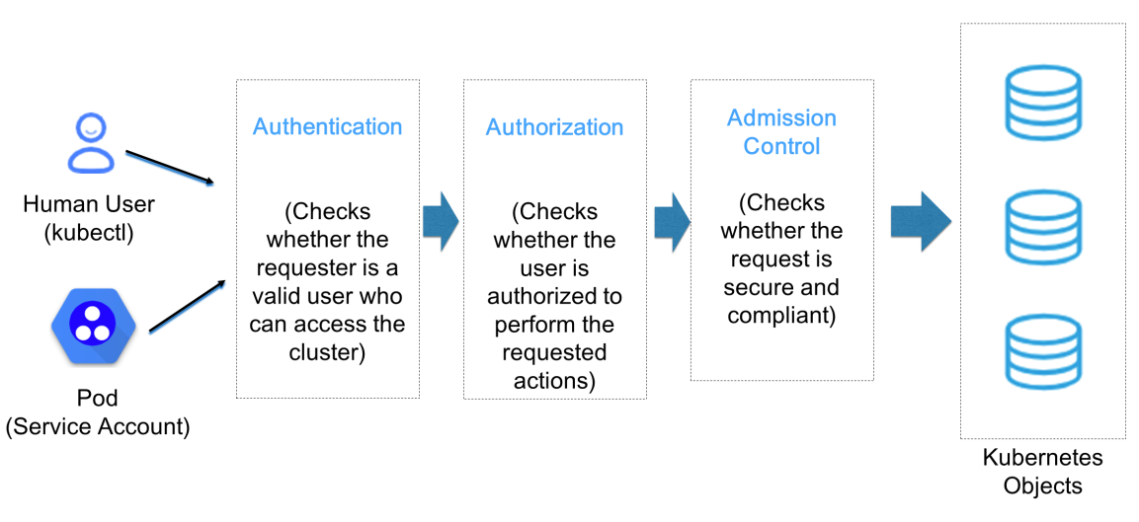
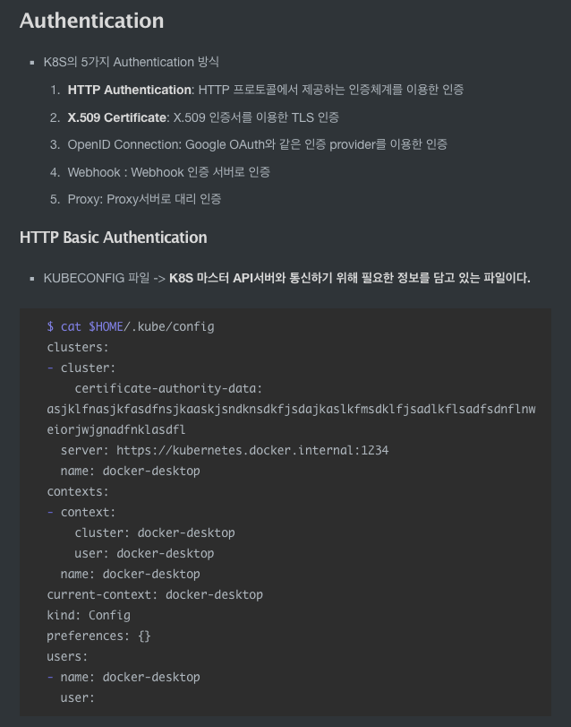
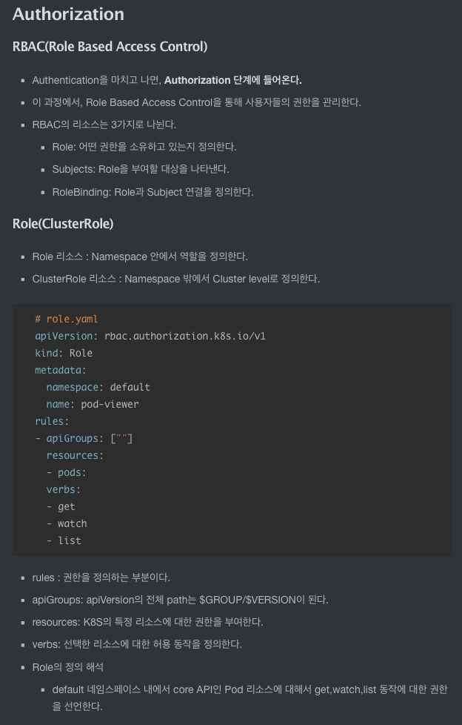
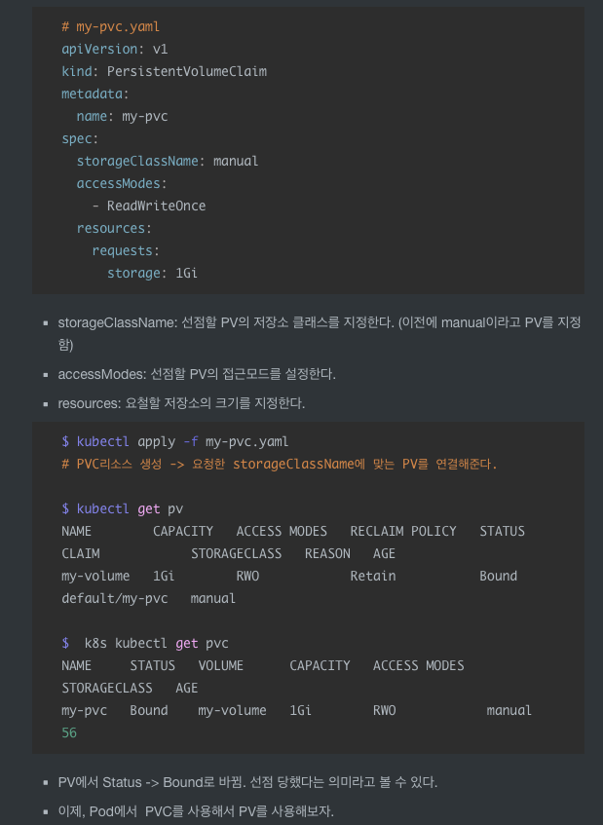
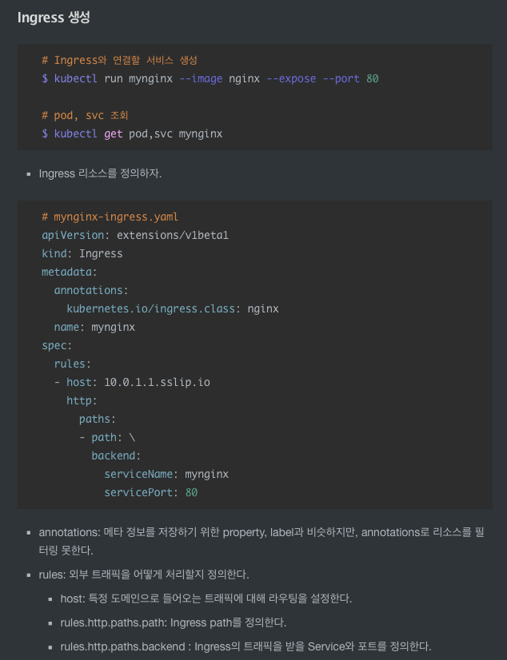
K8S Configuration Study
Ingress Resource
Storage Configuration
Access Control

Slide 31
Data Cleaning (Old)
Bronze Table
Silver Table
Gold Table
Parsing
Column JOIN

Slide 32
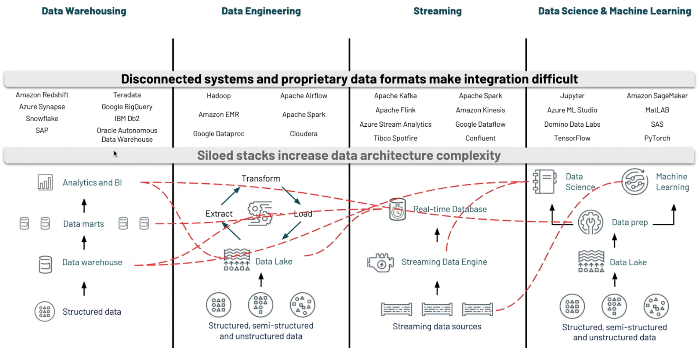
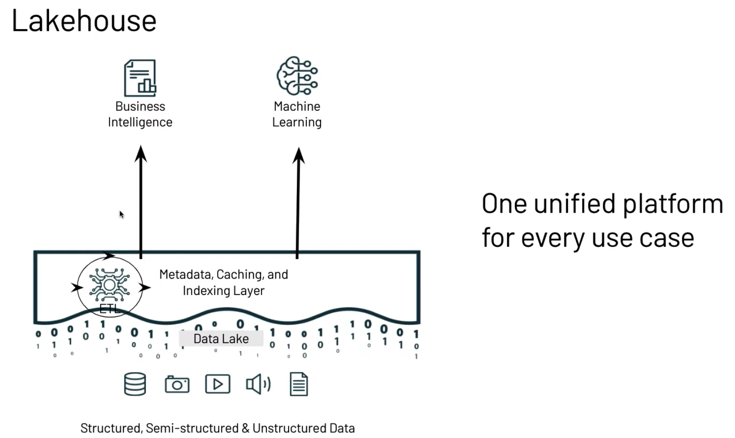

Purpose of Data Lakehouse

Slide 33
Purpose of Data Lakehouse

Slide 34
Purpose of Data Lakehouse

Slide 35


Data Cleaning
Data Cleaning
1. Remove duplicate or irrelevant observations
2. Fix structural errors
3. Filter unwanted outliers
4. Handle missing data
SSOT : Single Source Of Truth

Slide 36
Select Proper Data

Slide 37






K8S & Lakehouse

Slide 38
K8S & Lakehouse

Slide 39
K8S & Lakehouse
Cross Platform Management
CI/CD, Monitoring, Workflow
Easy to Scale out

Slide 40

K8S & Lakehouse
Cross Platform Management
CI/CD, Monitoring, Workflow
Easy to Scale out
Use Other tools in K8S Cluster
Machine Setting

Slide 41

Cloud-Native Lakehouse Cluster with MinIO Storage

Slide 42

Cleansing Tool
Roll Back
Schema Evolution
ID, Timestamp
Table Snapshot
1. explicitly altering the table schema
2. implicitly merging a DataFrame’s schema
to the table’s during the DataFrame’s write.
Support
Reading incremental changes to a table
Adding, dropping, updating, renaming, reordering
of
columns, fields, and/or nested structures
Support

Slide 43
Container Configuration
MinIO Client
Spark Cluster
MINIO_ACCESS_KEY = netai
MINIO_SECRET_KEY = netai0070
1. Integrate
Spark Cluster - MinIO
Spark-master
MinIO 1
box1
MinIO 2
box2
Read
Spark-worker
Write
MinIO 3
box3
MinIO 4
box4
2. Integrate
Spark Cluster - Delta Lake

Slide 44




Container Configuration
Validate Integration of 1 & 2

Slide 45
Cloud-Native Lakehouse Cluster with MinIO Storage

Slide 46

Container Configuration
MinIO Cluster

Slide 47


What is Apache Spark?
unified analytics engine for large-scale data processing
RDD -> Distributed Processing
RDD
1
1
3
1
2
2
3
1
Partition
Element
Transformation
Action
Manage Resource
1
3
2
Process allocated job

Slide 48


Why Spark on Kubernetes?
Spark on YARN
Spark on K8S

Slide 49
Why Spark on Kubernetes?

Slide 50


K8S Cluster Configuration
1 Master, 3 Workers
MinIO Error

Slide 51



K8S Cluster Configuration

Slide 52
Container Configuration
MinIO Cluster

Slide 53


K8S Setting & MinIO Setting

Slide 54


K8S Setting & MinIO Setting

Slide 55


Spark Cluster Setting
Error In Driver Image

Slide 56

To Do
Reset K8S to lower version
Use DirectCSI for installing MinIO on K8S

Slide 57


MinIO on K8S Setting
MinIO Basic
Hybrid Cloud : On-Premise + Public Cloud + Private Cloud
MinIO on K8S : Multi-tenant, K8S Namespace
MinIO Prerequisite before Install
MinIO K8S Operator -> able to Deploy MinIO Tenants in Hybrid Cloud Env
- CRD(Custom Resource Definitions) -> K8S Custom Resource
Use Krew Plugin Manager
DirectCSI : Creating Local PV, to ensure best object storage performance

Slide 58

MinIO on K8S Setting

Slide 59



Cloud Native Data Lakehouse with IoT Data

Slide 60




Cloud Native Data Lakehouse with IoT Data
K8S
Native
Spark
Cluster
Siren
Sound
Detection
Ambulance
Detection
Collision
Avoidance
Algorithm
GPS
MinIO
Cluster
Location
Calculation
GPS
…
Jetson Xavier
Ubuntu PC
RPI4
Vehicles
Server
Ambulance
GPS Data
Control Signal

Slide 61

Cloud Native Data Lakehouse with IoT Data
K8S
Native
Spark
Cluster
MinIO
Cluster
Location
Calculation
GPS
…
Ubuntu PC
RPI4
Server
Ambulance

Slide 62



MinIO Setting (Not a Main Part)
Each pod cannot Recognize Kubernetes-DNS Server
So, check CNI(Container Network Interface)
Replace CNI : weave-net -> Calico
Notes:
Spark 사용 : Server에서 여러대의 Veh, Amb들의 위치를 계산하여 구급차에게 알려주는 모델을 사용할때, 대용량 연산이 필요함.
하지만, Spark는 이미 들어온 데이터를 대용량 처리하는데 최적화 되어있고
Streaming 데이터를 처리하기에는 좋지 않다.
Autonomous smart pole
신호등 정보 -> 신호등이 분석할 수 있는 정보
자동자 자체의 정보 -> 자동차 측면에서 바라볼 수 있는 것을 어렵다.
Edge 상태에서 합쳐지는 역할.
모든 차들이 컴퓨터라고 생각하고, 중앙에서 하는 것이 컴퓨터,
협력을 해야하는데, 데이터적으로 정리된 것을 공유를 해야한다. -> 시간적으로 매칭.
모빌러티 요소를 가지고 컴퓨터들이 종합적으로 분석하게 하는, 다 모이면 모든 정보를 모은다. ->
엔터티를 협력을 계산. 급한 애들 부터 파악한다. -> 수소문 해서 찾는다. ㅏ신속하게 정리. 흐름을 보면
람다 아키텍쳐. 일단 쌓아놓고 분석하자.크게 보면,
기술적으로 보면 호숫가에 있는 창고,
서비스적으로 분석하고 보여주자.
흩어진 센서 정보 모아서 하나의 서비스를 제공ㅎ자.
나중에 바꿀 수 있다. -> 튜닝은 가능하다.
모아둔 정보 모아서 서비스를 하느 ㄴ트레드
전체적인 기술적으로 뭐를 팔아먹을까?-> 이제는 네트워킹 쪽으로 많은 것들이 엮여지는 이슈, 엣지라는 단어, 조금 더 팔 수 있고, 작년에 한 것이 너무 정적이다. 모이는 쪽에서는 서비스 메쉬, 안저ㅗㄱ에 들어가면 서비스 메쉬, 기술,
어떤 공간으로 침범하는 로직,

Slide 63
(Old) Cloud Native Data Lakehouse with IoT
K8S
Native
Spark
Cluster
MinIO
Cluster
Location
Calculation
GPS
…
Ubuntu PC
RPI4
Server
Ambulance

Slide 64


(New) Cloud Native Data Lakehouse with IoT
Kafka Cluster
broker
MinIO
Cluster
Location
Calculation
GPS
…
Ubuntu PC
RPI4
Server
Ambulance
Problem : Consumer, Producer ,Broker Setting

Slide 65


Kafka in Server Architecture (Cal @ IoT)
Calculation Flow
Vehicle
GPS
Ambulance
GPS
subscribe
Topic
Ambulance GPS
publish
Ambulance
GPS
Close Each Other?
Alert
Server With Kafka
Ambulance
Vehicle

Slide 66
(New) Cloud Native Data Lakehouse with IoT
Kafka Cluster
broker
Spark Cluster
Consumer
GPS
…
MinIO
Cluster
Location
Calculation
RPI4
Ambulance
Ubuntu PC
Server

Slide 67

Kafka in Server Architecture(Cal @ Server)
Calculation Flow
Vehicle
GPS
publish
Topic
Veh & Amb GPS
publish
Ambulance
GPS
subscribe
Spark Cluster
Alert
Ambulance
Close with any Amb?
Vehicle
Server With Kafka

Slide 68
Kafka in Server Architecture
This is a Alert Service, But is it okay to pass calculation to the IoT Device?
Server -> easy to monitoring
IoT Device -> calculation is easy

Slide 69


To do
1. Connect to Server When LTE Module is Arrived
2. Deploy Kafka Cluster and Test Sending GPS Info
3. Setup MinIO Cluster..

